Slide 1
Capstone Engagement
Assessment, Analysis, and Hardening of a Vulnerable System by Junior Stanley Paruthiyil

Slide 2
Table of Contents
This document contains the following sections:
01
Network Topology
02
Red Team: Security Assessment
03
Blue Team: Log Analysis and Attack Characterization
Hardening: Proposed Alarms and Mitigation Strategies
04

Slide 3
Network Topology
3

Slide 4
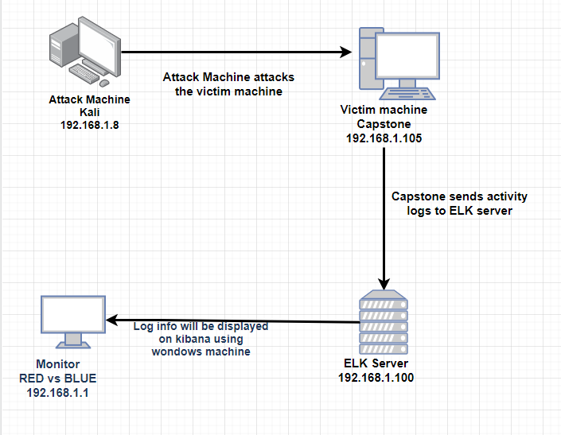
Network Topology
Network
Address Range: 192.168.1.0/24
Netmask: 255.255.255.0
Gateway: 192.168.1.1
Machines
IPv4: 192.168.1.8
OS: Linux 3.7 – 3.10
Hostname: Kali
IPv4:192.168.1.105
OS: Linux
Hostname: Capstone
IPv4: 192.stn
NETWORK
Address range:
192.168.1.0/24
Netmask:255.255.255.0
Gateway:192.168.1.1
Machines
IPv4:192.168.1.8
OS:Linux
Hostname: Kali
IPv4: 192.168.1.105
OS: Linux
Hostname: Capstone
IPv4: 192.168.1.100
OS:
Hostname: Linux
IPv4: 192.168.1.1
OS: Windows
Hostname: RED vs BLUE-
ML-REFVM

Slide 5

Red Team
Security Assessment
5

Slide 6
Recon: Describing the Target
Nmap identified the following hosts on the network:
Hostname | IP Address | Role on Network
Red vs Blue ML-REFVM | 192.168.1.1 | Windows virtual host name to view log data
Kali | 192.168.1.8 | Attacking Machine
Capstone | 192.168.1.105 | Vulnerable Machine
ELK | 192.168.1.100 | Logs from Capstone machine

Slide 7
Vulnerability Assessment
The assessment uncovered the following critical vulnerabilities in the target:
Vulnerability | Description | Impact
Port 80 is open | Attackers can assess the private information if the port is open , also cause data breach. | This allowed the red team to find the secret directory and also were able to access files
Brute forcing the password | When the password is easy to guess, it can be found by brute force tool wordlist and can be hacked. | Red team was able to brute force Ashton’s password which was Leopoldo, and access the secret files.
Files which can be assessed | Web servers, FTP servers stores files in the root directory which is assessed by server users. | This allowed the red team to view files after assessing the IP on port 80.From here red team got server’s users and secret file information.
Hashed password is found | A hashed password can be cracked through different tools like hashcat, John the Ripper. | Red team used md5cracker and identified password of John which was linux4u

Slide 8
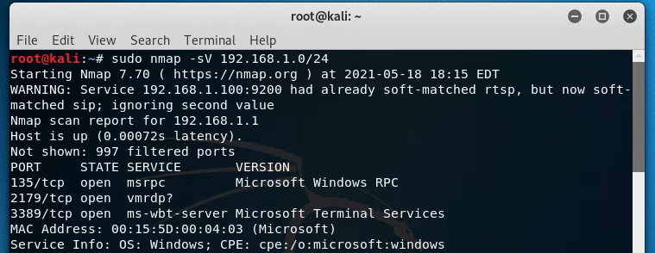
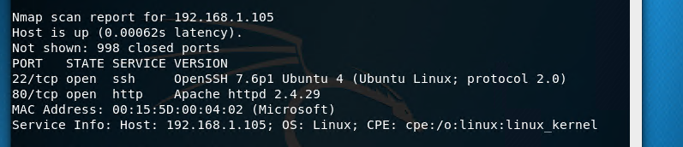
Exploitation: Open Port 80
01
03
Tools & Processes
We used Nmap to scan any ports which is open also other services in the network
02
Achievements
We found that IP address 192.168.1.105 had an open port 80, through which we were able to access a directory with important files.

Slide 9
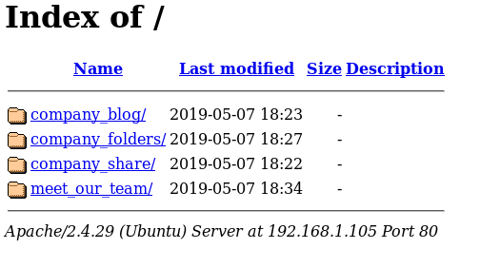
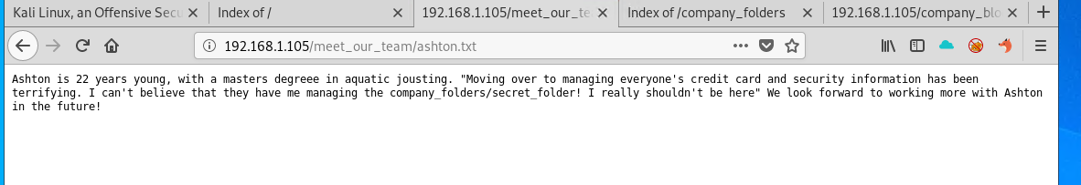
Exploitation: Accessible Files
03
01
Tools & Processes
Using port 80, we opened a web browser to see if there was anything important to view.
02
Achievements
Accessing the files gave us information about users and also the secret files and where it is located.

Slide 10
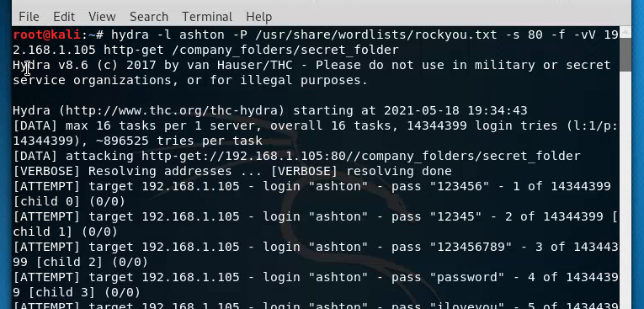
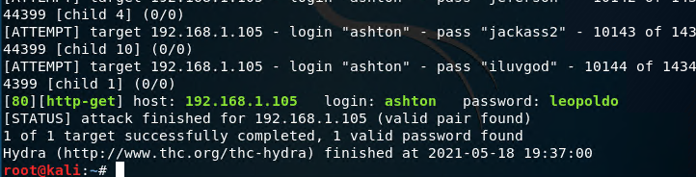
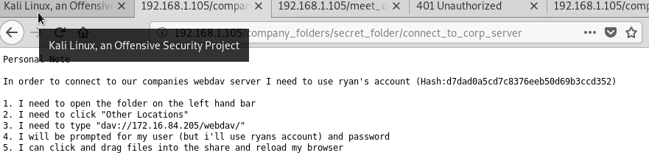
Exploitation: Brute Force Password
03
01
Tools & Processes
We used tool Hydra to brute force Ashton’s password using the username: ashton
02
Achievements
The exploit granted us user shell access into the victim machine so we could navigate to the secret files.

Slide 11
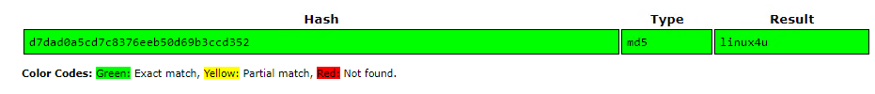
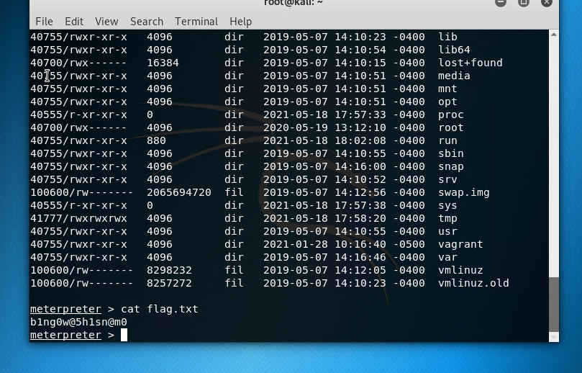
Exploitation : Hashed Password
01
Tools & Processes
We used the website crack station to find the plaintext of the hashed password for Ryan
02
Achievements
This password granted us access to the system through the WebDAV connection, which later allowed us to upload a shell script to attack.

Slide 12

Blue Team
Log Analysis and Attack Characterization
12

Slide 13

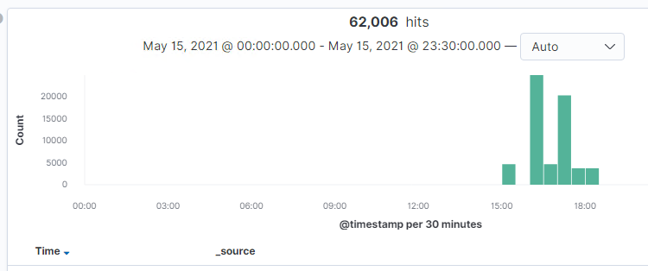
Analysis: Identifying the Port Scan
The port scan began at 3:00 pm
62,006 packets were send from ip 192.168.1.8
The nmap ping scan send request to port 80 and port 443
[Insert Here]
Include a screenshot of Kibana logs depicting the port scan.

Slide 14
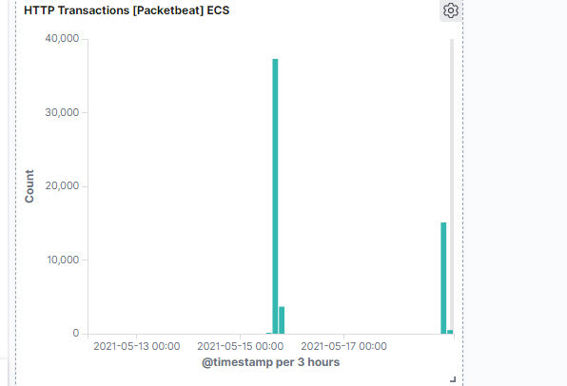
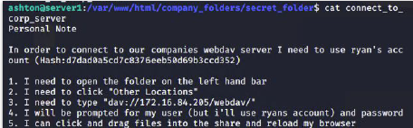
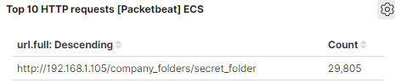
Analysis: Finding the Request for the Hidden Directory
29,805 requests for the hidden directory occurred at 6pm.
The file requested was a secret folder hidden within the company folders.
The secret folder contained instructions on how to access the webdav server using Ryan’s account. It also included a hashed password.

Slide 15
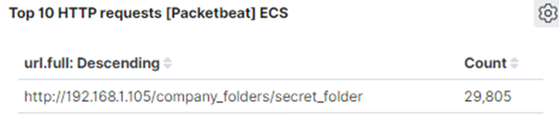
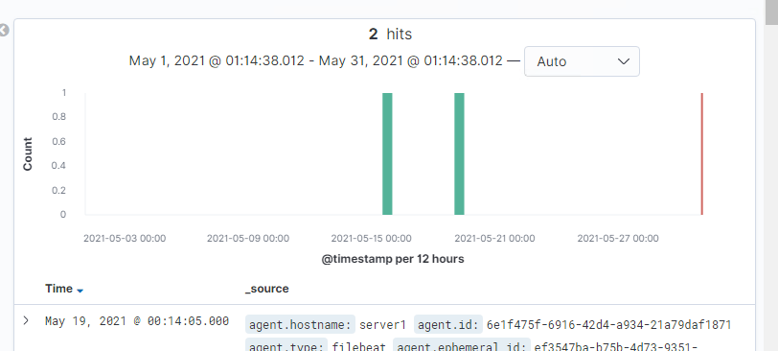
Analysis: Uncovering the Brute Force Attack
29,805 requests were made.
Out of 29,805 request , only 2 successful attempt in recovering the password.

Slide 16
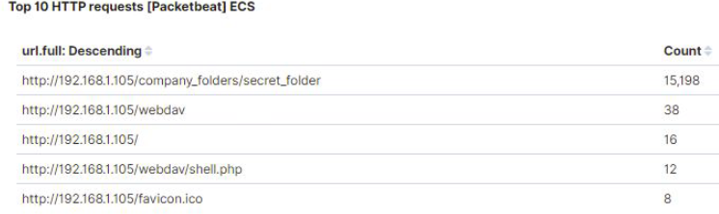
Analysis: Finding the WebDAV Connection
38 requests were made to the WebDav directory.
The shell.php file was requested. This was part of the red team’s shell attack to start listening for activity on the victim machine.

Slide 17
Blue Team
Proposed Alarms and Mitigation Strategies
17

Slide 18
Mitigation: Blocking the Port Scan
We will set up an alarm, so that a firewall detects 10 port scans per minute or 100 ICMP request which is consecutive.
Most firewalls and IPSs can detect such scanning and cut it off in real time.
Enable only the traffic you need to access the internal hosts and deny everything else.
This goes for standard ports, such as TCP 80 for HTTP and ICMP for ping request.

Slide 19
Mitigation: Finding the Request for the Hidden Directory
We will set an alert that goes off for any machine that attempts to access this directory or file.
The threshold will be more than one attempt.
Remove the directory and file from the server.
Command to remove directory
rm –r ../company_files
We can also move the directory to a safer or offline location.

Slide 20
Mitigation: Preventing Brute Force Attacks
We will set an alert if ‘401 Unauthorised’ is returned from server that would weed out the forgotten passwords. Start with 10 attempts in one hour then you can refine from there.
We will also create an alert if the user agent value includes Hydra in the name.
After the limit of 10 ‘401 Unauthorised’ codes have been returned from a server, that server can automatically drop traffic from the offending IP address for a period of one hour
The most obvious way to block brute-force attacks is to simply lock out accounts after a defined number of incorrect password attempts. Account lockouts can last a specific duration, such as one hour, or the accounts could remain locked until manually unlocked by an administrator.

Slide 21
Mitigation: Detecting the WebDAV Connection
We can create an alert anytime when this directory is accessed, by a mahine other than one which is not authoried
The threshold can be set at more than one attempt.
Connections to this shared folder should not be accessible from the web interface
Connections to this shared folder could be restricted by machine with a firewall rule.

Slide 22
Mitigation: Identifying Reverse Shell Uploads
We can set an alert for any traffic moving over port 4444.
Set an alert for any .php file that is uploaded to the server.
The threshold should be more than one attempt.
Require authentication to upload files.
Store uploaded files in a location should not accessible from the web.
Scramble uploaded file names and extensions.
Define valid types of files that the users should be allowed to upload.

Slide 23
Takeaway

Slide 24
Takeaway
As a company, always should be prepared for a security breach.
RED TEAM: BLUE TEAM :
Opened port 80 * Identified port scan
Accessed sensitive files * Found request for hidden directory
Brute-forced to gain access * Uncovered the brute force attack.
Un-hashed password to gain * Found the WebDav connection
access into the and inject a
shell script
Continuous monitoring and communication between the security team and the employees will ensure swift response and prevention to attacks.

